Slide 1

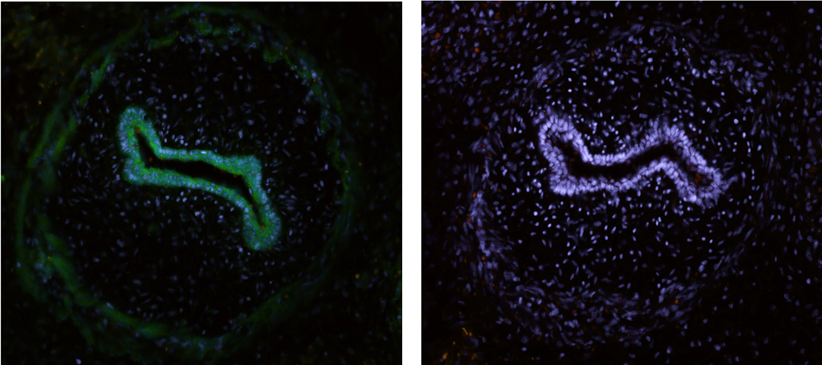
ReliaTech GmbH
Rabbit anti-rat PlGF
(Cat #104-PA04S; #104-PA04 )
Figure: Rat embryonic intestinal tissue labeled with polyclonal antibody against rat PlGF (green) [Cat# 104-PA04]. The sections were fixed with 4% PFA. Staining with polyclonal anti-rat PlGF antibody in gut epithelial cells (left panel), and negative control (right panel).
The experiment was performed by the research group of Prof. Dr. J. Wilting and Dr. K. Buttler, University Medicine Göttingen, Germany.
http://www.reliatech.de / orders@reliatech.de

